Slide 1
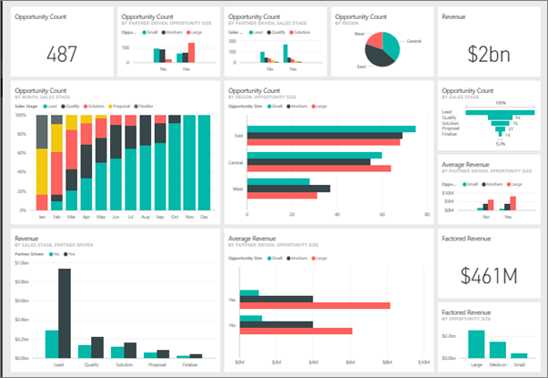


Power BI: Empowering Data-driven Insights
FRANCIS CARLO A. TADENA

Slide 2
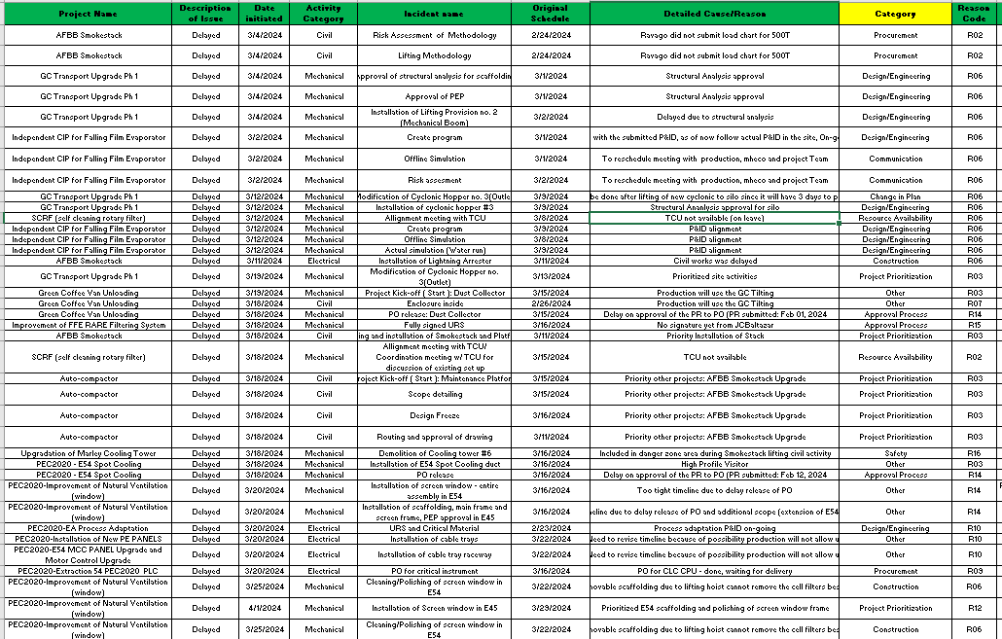
Introduction to Power BI: Empowering Data-driven Insights
A powerful business intelligence tool that enables organizations to transform data into meaningful insights.

Slide 3
Why not use Excel?
Limited Data Visualization:
Excel's data visualization capabilities are not as advanced as those offered by dedicated business intelligence tools like Power BI.
Creating complex and interactive visualizations can be challenging and time-consuming in Excel.

Slide 4
Why not use Excel?
Scalability and Performance:
Excel may struggle to handle large datasets efficiently, leading to slower calculations and performance issues. Power BI, on the other hand, is designed to handle big data and complex calculations more effectively.

Slide 5
Why not use Excel?
Real-time Data Analysis:
Excel lacks the ability to connect to real-time data sources, limiting its capability for real-time analysis. Power BI can connect to live data sources, enabling users to monitor key metrics and make timely decisions.

Slide 6
Why not use Excel?
Collaboration and Sharing:
Excel's collaboration features are limited compared to Power BI.
Power BI allows for easy sharing of reports, dashboards, and datasets, facilitating collaboration among team members and ensuring everyone has access to up-to-date insights.

Slide 7
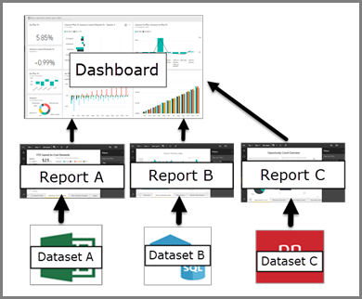
Why not use Excel?

Slide 8
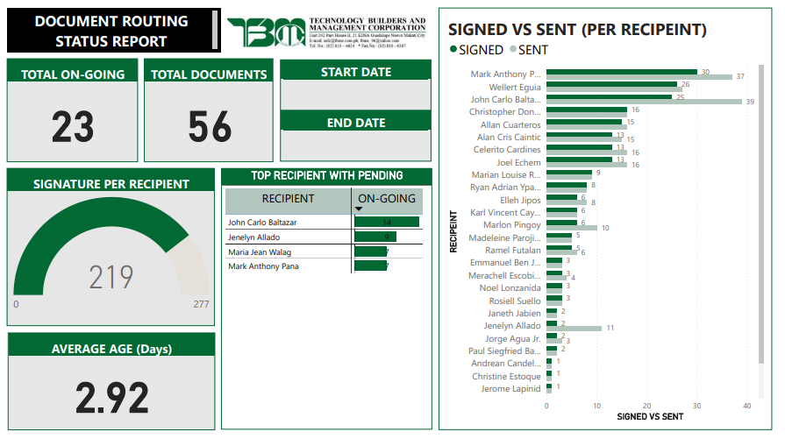
Example Usage: DocuSign1
PAGE 1

Slide 9
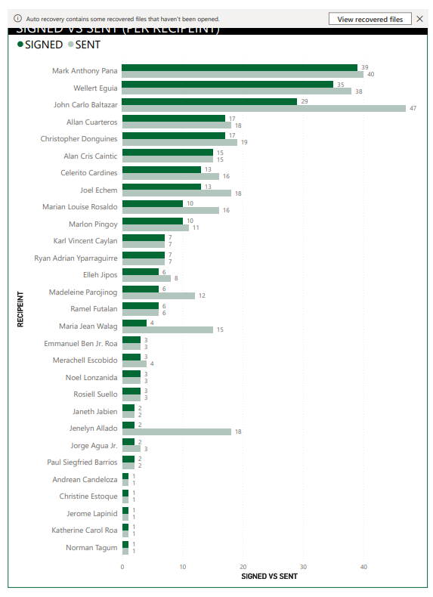
Example Usage: DocuSign1
PAGE 2

Slide 10
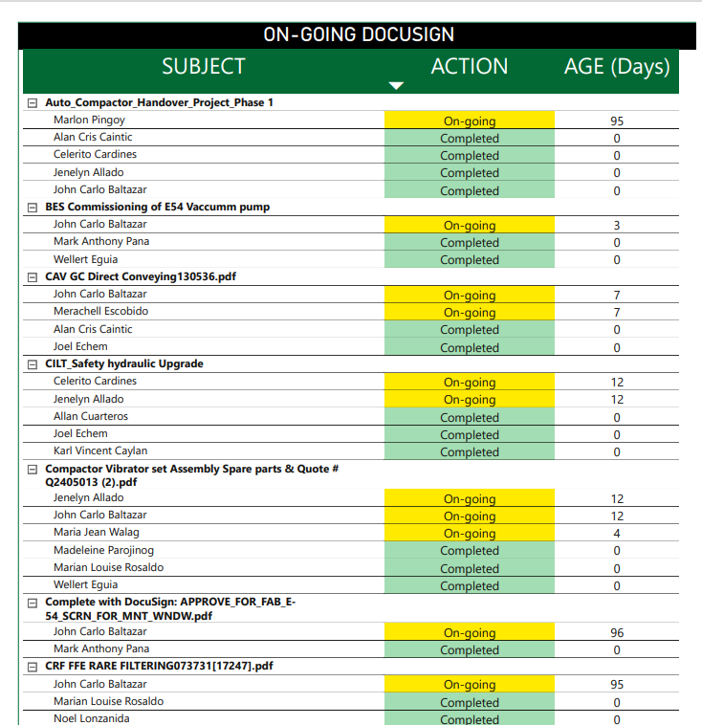
Example Usage: DocuSign1
PAGE 3

Slide 11
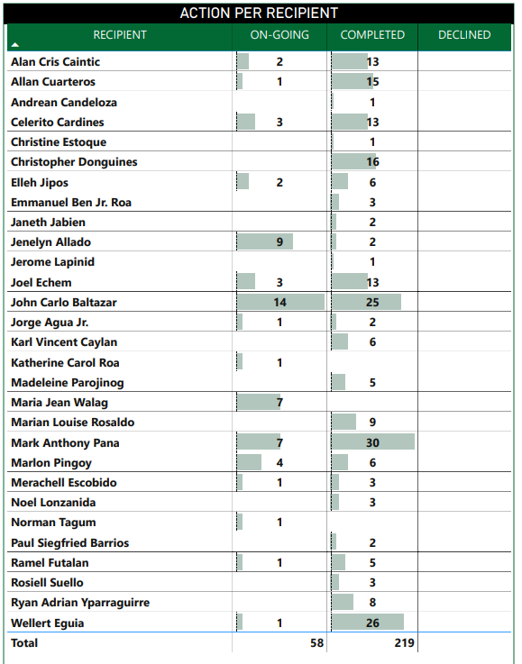
Power BI: Empowering Data-driven Insights
PAGE 4

Slide 12
Data Source: Transforming & Cleaning
Power BI is a cloud-based business analytics service provided by Microsoft.
It allows users to connect to a wide range of data sources, create interactive reports and dashboards, and share insights across the organization.

Slide 13
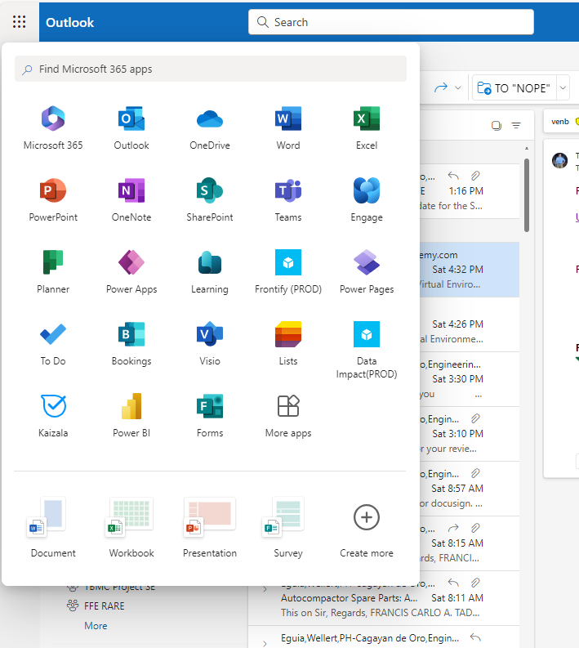
Quick guide:
Step 1: Open Power BI on your MS360 Apps

Slide 14
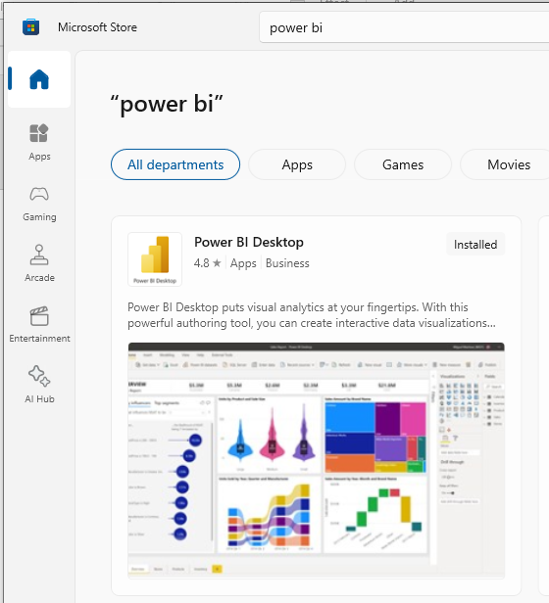
Quick guide:
Step 1: or Download the Desktop version. (This is allowed and free for our MS360 accounts)

Slide 15
Quick guide:
Step 2: (demo)
DEMO

Slide 16
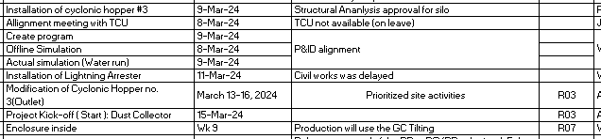
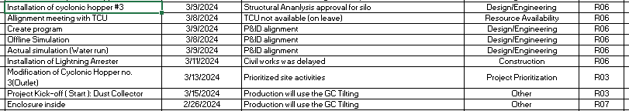
Data cleaning & transformation.

Slide 17
Your Data
Must be clean & transformed if necessary.
Data from 3rd party applications (SAP, DocuSign, etc) are easier to handle rather than manually updated.
But if data is manually updated in excel, then it may require some cleaning.

